Slide 1
Unit 05: Circuit Families

Slide 2
Outline
Basic CMOS Circuits
Combinational Circuits
Sequential Circuits
Slide <number>

Slide 3
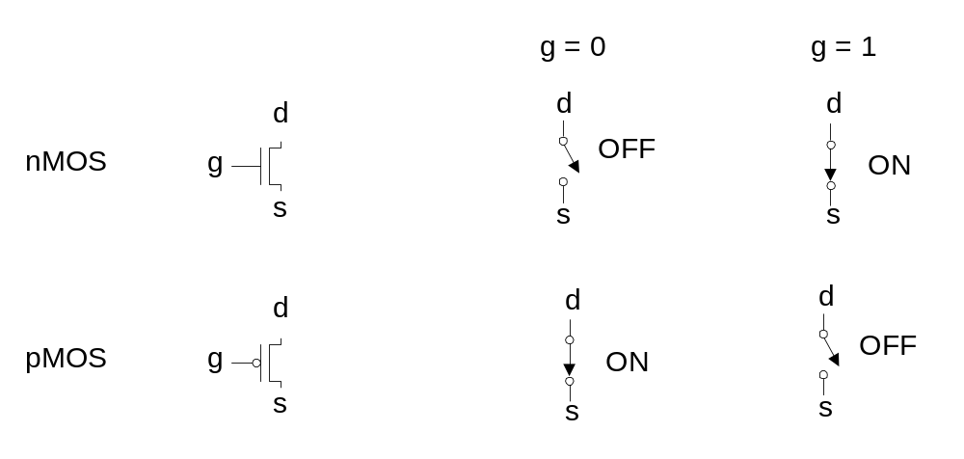
Transistors as Switches
We can view MOS transistors as electrically controlled switches
Voltage at gate controls path from source to drain
Slide <number>

Slide 4
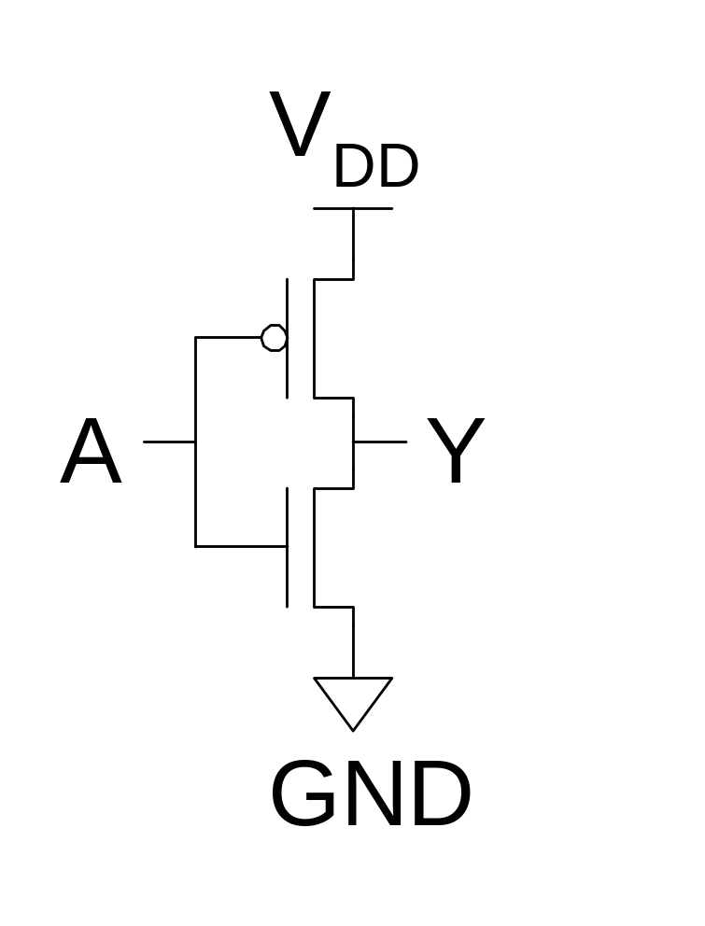
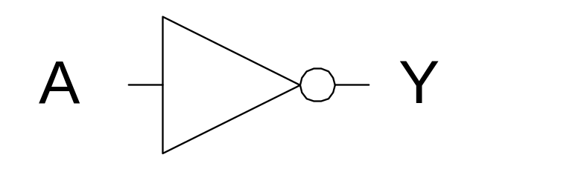
CMOS Inverter
A | Y
0
1
Slide <number>

Slide 5
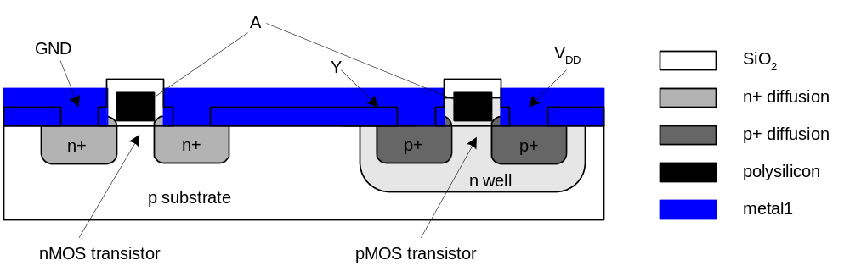
Inverter Cross-section
Typically use p-type substrate for nMOS transistors
Requires n-well for body of pMOS transistors
Slide <number>

Slide 6
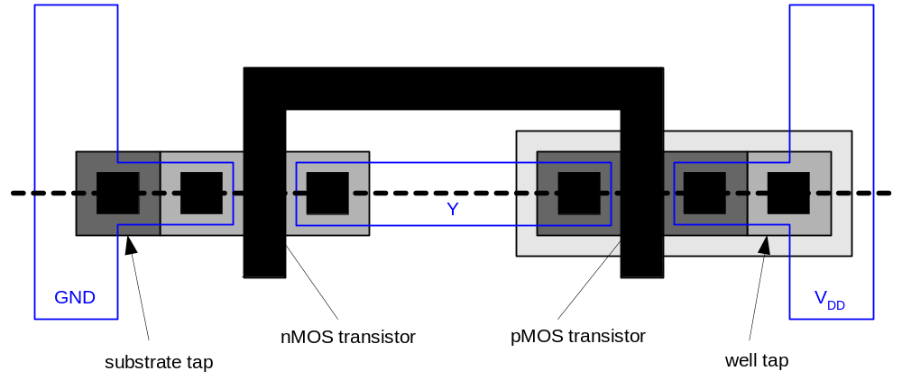
Inverter Mask Set
Transistors and wires are defined by masks
Cross-section taken along dashed line
Slide <number>

Slide 7
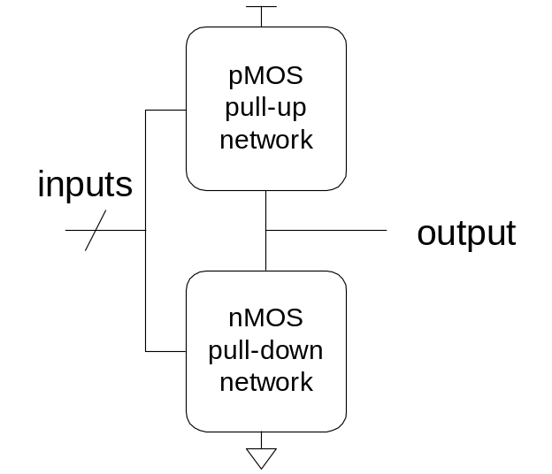
Complementary CMOS
Complementary CMOS logic gates
  nMOS pull-down network
  pMOS pull-up network
  a.k.a. static CMOS
 | Pull-up OFF | Pull-up ON
Pull-down OFF | Z (float) | 1
Pull-down ON | 0 | X (crowbar)
Slide <number>

Slide 8
Gate Layout
Layout can be very time consuming
  Design gates to fit together nicely
  Build a library of standard cells
Standard cell design methodology
  V_{DD} and GND should abut (standard height)
  Adjacent gates should satisfy design rules
  nMOS at bottom and pMOS at top
  All gates include well and substrate contacts
Slide <number>

Slide 9
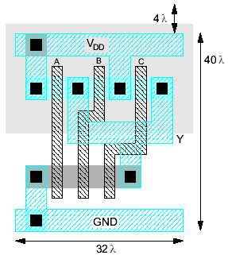
Example: NAND3
Horizontal N-diffusion and P-diffusion strips
Vertical polysilicon gates
Metal1 V_{DD} rail at top
Metal1 GND rail at bottom
32 λ by 40 λ
Slide <number>

Slide 10
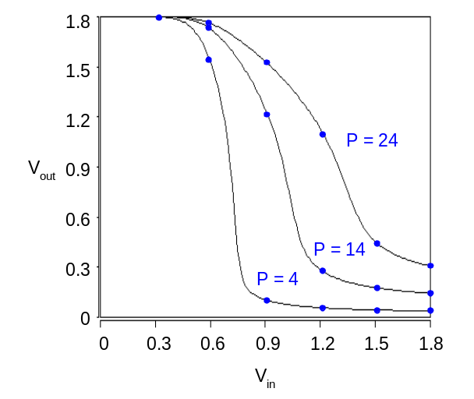
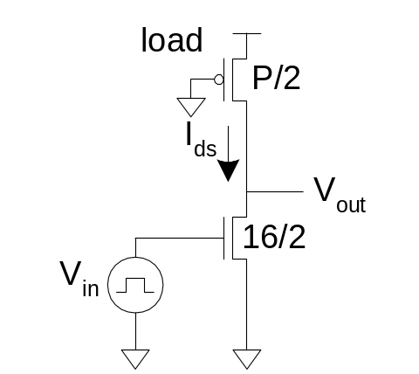
Pseudo-nMOS
In the old days, nMOS processes had no pMOS
  Instead, use pull-up transistor that is always ON
In CMOS, use a pMOS that is always ON
  Ratio issue
  Make pMOS about ¼ effective strength of pulldown network
Slide <number>

Slide 11
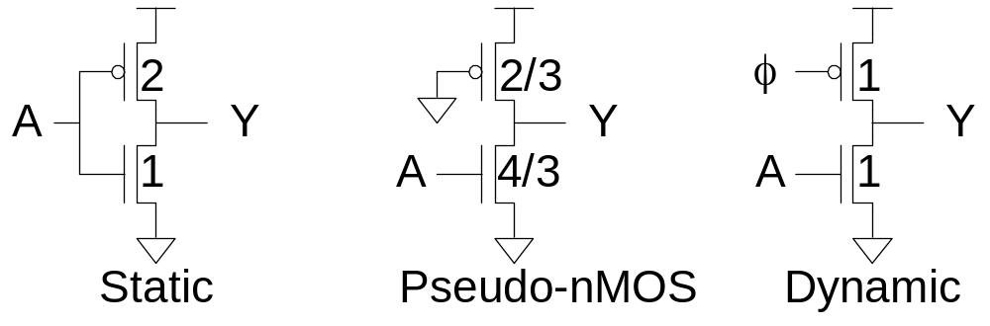
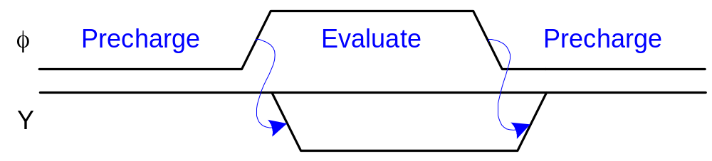
Dynamic Logic
Dynamic gates uses a clocked pMOS pullup
Two modes: precharge and evaluate
Slide <number>

Slide 12
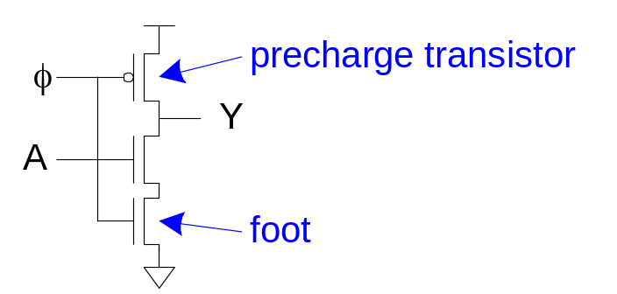
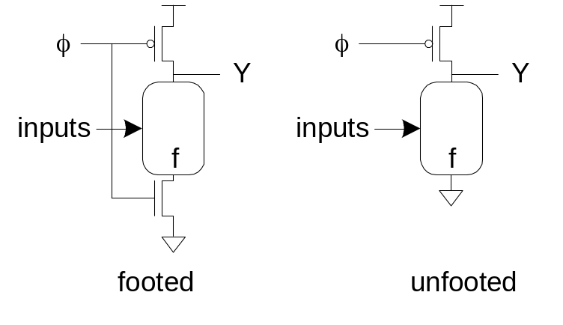
The Foot
What if pulldown network is ON during precharge?
Use series evaluation transistor to prevent fight.
Slide <number>

Slide 13
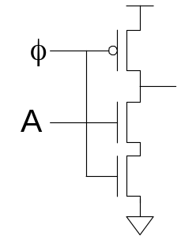
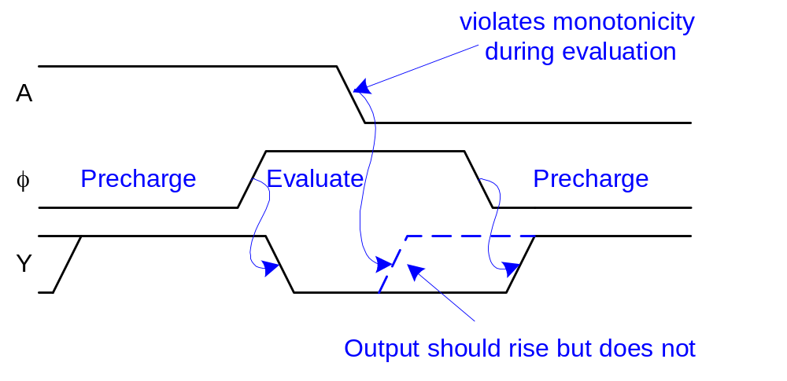
Monotonicity
Dynamic gates require monotonically rising inputs during evaluation
  0 -> 0
  0 -> 1
  1 -> 1
  But not 1 -> 0
Slide <number>

Slide 14
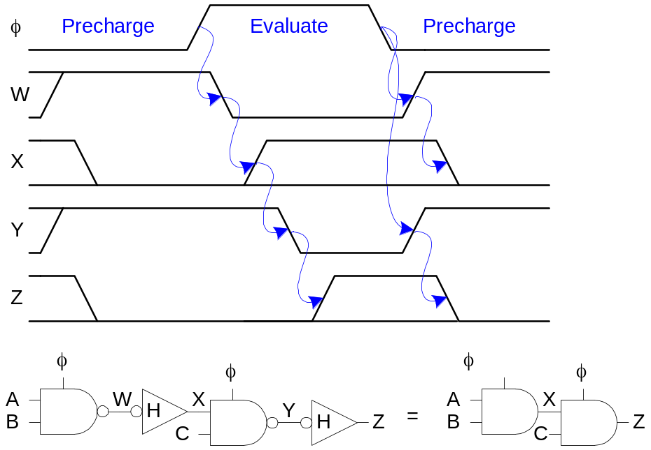
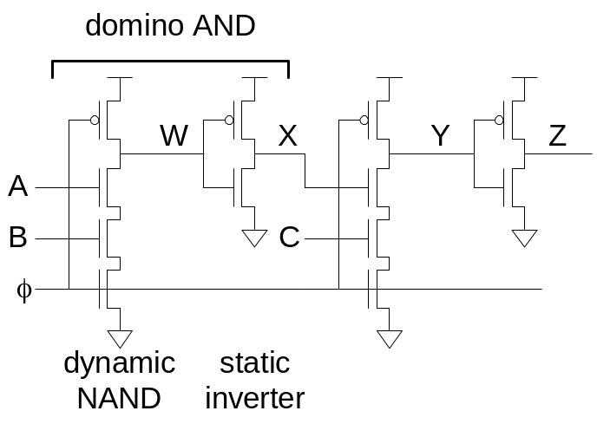
Domino Gates
Follow dynamic stage with inverting static gate
  Dynamic / static pair is called domino gate
  Produces monotonic outputs
Slide <number>

Slide 15
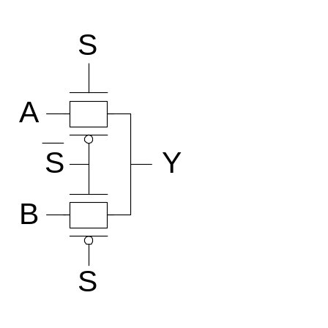
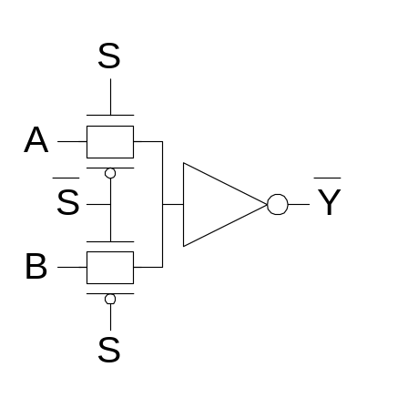
Pass Transistor Circuits
Use pass transistors like switches to do logic
Inputs drive diffusion terminals as well as gates
CMOS + Transmission Gates:
  2-input multiplexer
  Gates should be restoring
Slide <number>

Slide 16
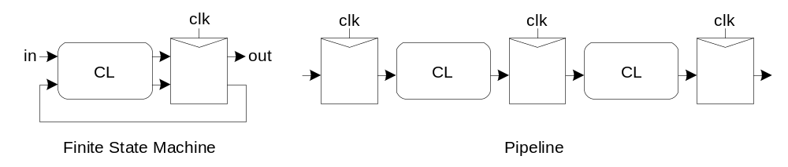
Sequencing
Combinational logic
  output depends on current inputs
Sequential logic
  output depends on current and previous inputs
  Requires separating previous, current, future
  Called state
  Ex: FSM, pipeline
Slide <number>

Slide 17
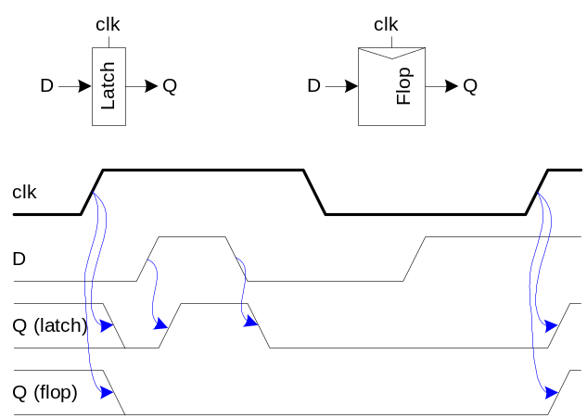
Sequencing Elements
Latch: Level sensitive
  a.k.a. transparent latch, D latch
Flip-flop: edge triggered
  A.k.a. master-slave flip-flop, D flip-flop, D register
Slide <number>

Slide 18
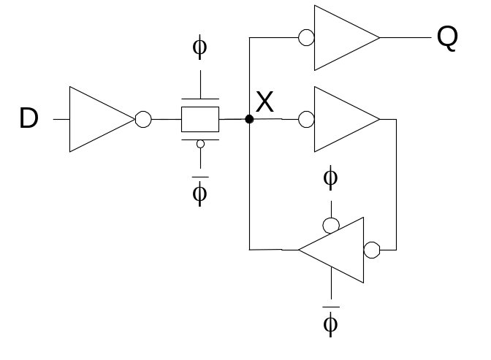
Latch Design
Buffered output
  + No backdriving
Widely used in standard cells
  + Very robust (most important)
  Rather large
  Rather slow
  High clock loading
Slide <number>

Slide 19
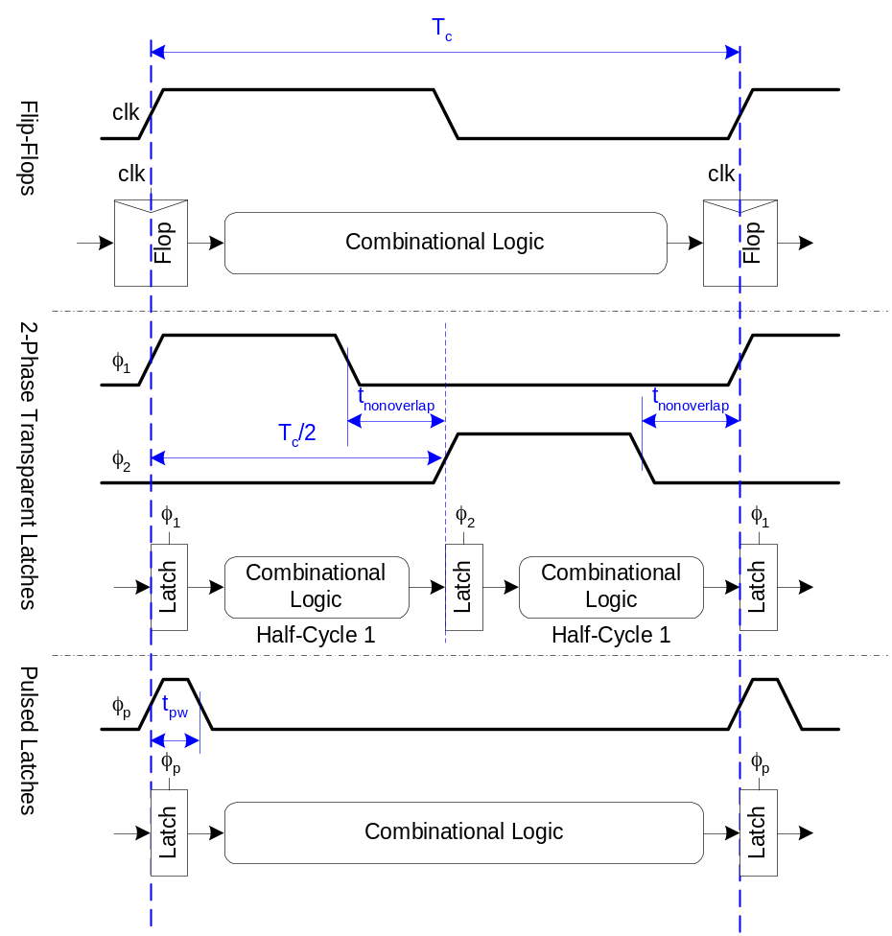
Sequencing Methods
Flip-flops
2-Phase Latches
Pulsed Latches
Slide <number>

Slide 20
Clocking Summarized
Flip-Flops:
  Very easy to use, supported by all tools
2-Phase Transparent Latches:
  Lots of skew tolerance and time borrowing
Pulsed Latches:
  Fast, hold time risk
Slide <number>

